Slide 1
Welcome to My Presentation

Slide 2
Name: Md. Fahim Ahmed Batch: 031 serial no: 01-031-16 Course: Computer Fundamentals

Slide 3
Agenda
What is Loan Amortization.
Purpose of Loan Amortization.
Components of a Loan Amortization Calculator.
Benefits of Using a Loan Amortization Calculator.
How May I Prepare a Amortization Calculaor.

Slide 4
What is Loan Amortization & Amortization Calculator
Loan amortization is the process of scheduling out a fixed-rate loan into equal payments.
An amortizing loan has fixed, periodic payments that are applied to both the principal and interest until the loan is paid in full.
Amortization calculator is used to determine the periodic payment amount due on a loan (typically a mortgage), based on the amortization process.

Slide 5
Purpose of Loan Amortization.
Equal Payments: Amortization schedules ensure that borrowers make equal payments over the loan term, which includes both principal and interest.
Principal Reduction: Through amortization, a portion of each payment goes towards reducing the principal amount owed.
Interest Calculation: Amortization schedules outline how much of each payment goes towards interest versus principal.

Slide 6
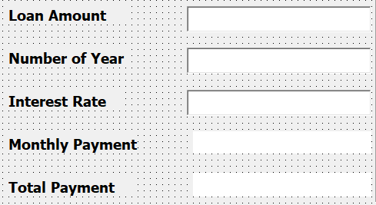
Components of a Loan Amortization Calculator
To prepare an amortization calculator we need principal amount (money) loan interest rate, type of repayment (annual, monthly quarterly, semi-annually) etc.

Slide 7
Benefits of Using a Loan Amortization Calculator.
Understanding Repayment Structure: They help borrowers understand how their loan payments are structured over time.
Budgeting and Planning: By providing a breakdown of payments over the loan term, these calculators allow borrowers to plan their finances more effectively.
Comparing Loan Options: Borrowers can use amortization calculators to compare different loan options.
Early Repayment Analysis: Borrowers can use amortization calculators to analyze the impact of making extra payments or paying off the loan early.

Slide 8
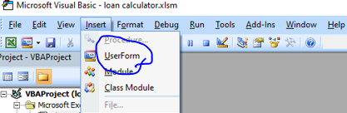
How Can I Prepare a Amortization Calculaor in VBA
Open Excel and Access VBA Editor: Open Excel and press ALT + F11 to open the VBA Editor
Click Insert Tab and select Userform like followings way

Slide 9
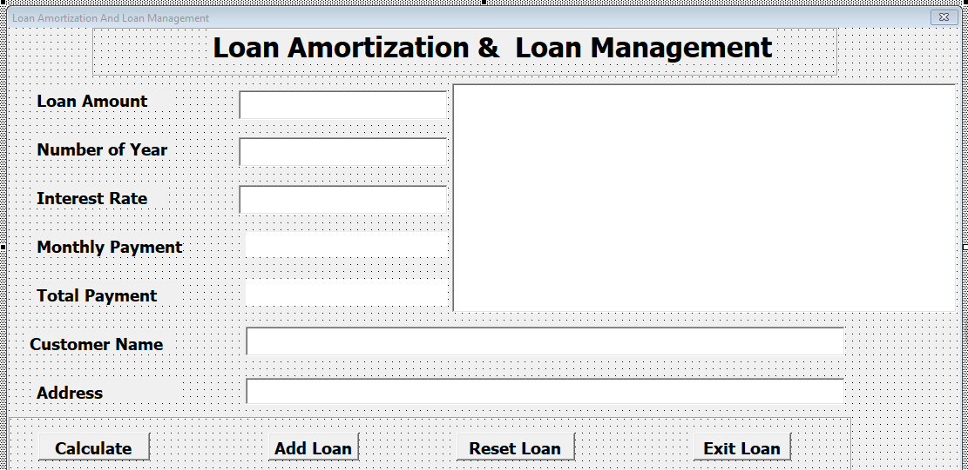
How Can I Prepare a Amortization Calculaor in VBA
Prepare a amortization calculator form insert necessary button , Display and others Add loan or
Reset, Exit etc.

Slide 10
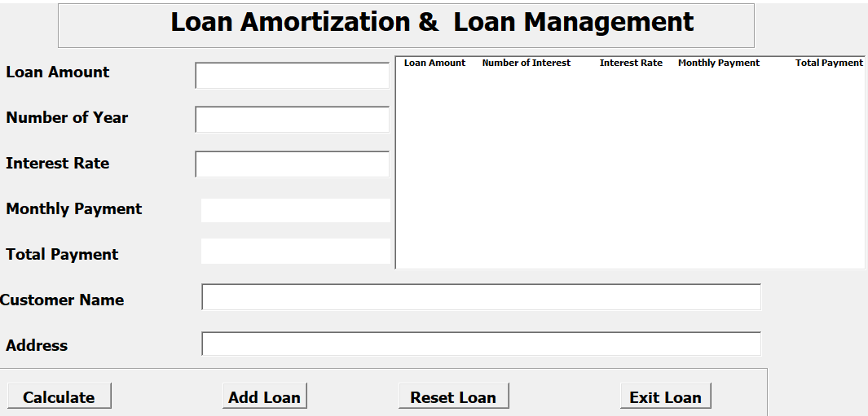
How Can I Prepare a Amortization Calculaor in VBA
Write the VBA code for each button to perform the calculations.
Finally if we run the calculator after proper coding we will get a perfect amortization calculator.

Slide 11
Thank you

